Slide 1

Exploratory Data Analysis
Notes:
Gemini prompt: Data Scientists working on Exploratory Data Analysis of Penguin Data.

Slide 2
Learning Objectives
Define and explain the importance of EDA in the data science workflow.
Perform various data cleaning and preprocessing steps.
Utilize descriptive statistics to summarize data distributions.
Apply a range of data visualization techniques to uncover patterns and relationships.
Identify outliers, missing values, and data inconsistencies.
Formulate and test hypotheses based on EDA findings.
Implement EDA techniques using Python libraries such as Pandas, Matplotlib, Seaborn, and Scipy.

Slide 3
Data Science Lifecycle
Define Problem
Identify Data Location
Manage Metadata
Extract, Transform, Load
Join/Merge Tables
Profile Data
Data Type and Validation Check
Regulatory/PII Check
Manage-Measure
Acquire Data
Data Platform
Clean Data (Missing Values, Outliers, Duplicates, Var names)
EDA (Univariate, Bivariate, Multivariate analysis, Visualization)
Feature Engineering
Prepare Analytic Data Set (ADS) (Standardization/Normalization, Category encoding)
Deploy Model
Prepare Data
Build Model

Slide 4
What is the difference between Data Prep and EDA?
Aspect | Data Preparation | Exploratory Data Analysis (EDA)
Primary Goal | Clean and transform data to make it ready for modeling | Understand the data, discover patterns, generate insights
Focus | Cleaning, formatting, and transformation | Analysis, visualization, hypothesis generation
Typical Questions | Are there missing values? Are formats consistent? Are features encoded properly? | What does the distribution look like? Are variables correlated? Are there anomalies?
Key Activities | - Handling missing data - Encoding categorical variables - Normalization/standardization - Removing duplicates & outliers - Data type conversions - Train/test splitting | - Summary statistics (mean, median, variance) - Visualizations (histograms, scatterplots, heatmaps) - Detecting trends, clusters, anomalies - Correlation analysis
Output | Clean, well-structured dataset ready for modeling | Insights, hypotheses, understanding of data structure and relationships
When Used | After or alongside EDA, before modeling | Early stage of analysis, often iteratively with preparation
Tools/Methods | Data wrangling libraries (Pandas, NumPy, SQL), preprocessing functions (scikit-learn, PySpark, AWS Glue) | Visualization libraries (Matplotlib, Seaborn, Plotly), statistical summaries, hypothesis tests
🔑 Takeaway:
They highly overlap
You need both
In practice, you combine the approaches
Data Preparation is about fixing (cleaning & structuring).
EDA is about exploring (diagnosis, discovery, hypotheses).

Slide 5
What is Exploratory Data Analysis?
Definition: Exploratory Data Analysis (EDA) is an approach to analyzing data sets to summarize their main characteristics, often with visual methods. It's about understanding the data and finding insights.
Goal: To uncover patterns, spot anomalies, test hypotheses, and check assumptions with the help of summary statistics and graphical representations.
Analogy: Think of it like being a detective. Before you solve the case (build a model), you need to investigate the scene (your data) thoroughly.

Slide 6
Why is EDA Important?
Before Modeling: EDA is a critical step before building predictive models. A good model on bad data is still a bad model!
Pattern Discovery: Reveals underlying structures, patterns, and relationships within the data.
Hypothesis Generation: Helps formulate hypotheses about the data that can be tested later.
Feature Engineering: Informs decisions about how to create new features.
Communication: Provides a clearer understanding to communicate insights to stakeholders.
Many times, EDA is the objective of the project.

Slide 7
The Data Prep/EDA workflow
4. Univariate Analysis
Examine one variable at a time.
Visualize with histograms, bar charts, boxplots.
Check distribution shapes (normality, skewness, kurtosis).
5. Bivariate / Multivariate Analysis
Explore relationships between two or more variables.
Use scatterplots, heatmaps, pairplots, cross-tabulations.
Check correlations and potential causality signals.
6. Feature Engineering
Encoding (categorical → numeric).
Scaling (normalization/standardization).
Transformation (log, square root for skewness).
Create derived features (ratios, time lags, etc.).
7. Data Visualization
Build plots for patterns and trends.
Highlight anomalies or clusters.
Use advanced tools (seaborn, matplotlib, Plotly, Tableau).
1. Data Collection & Loading
Gather data from databases, APIs, files (CSV, Excel, Parquet, etc.), or cloud storage.
Load into analysis tools (Python, R, SQL, notebooks).
2. Data Cleaning & Preprocessing
Handle missing values (drop, impute, or flag).
Detect and treat outliers.
Standardize data types (numeric, categorical, datetime).
Remove duplicates and inconsistencies.
3. Data Profiling & Summary Statistics
Inspect shape, size, and structure of data (rows, columns).
Use descriptive statistics: Mean, median, mode, standard deviation, quantiles.
Frequency counts for categorical variables.
Create correlation matrices to see relationships.

Slide 8
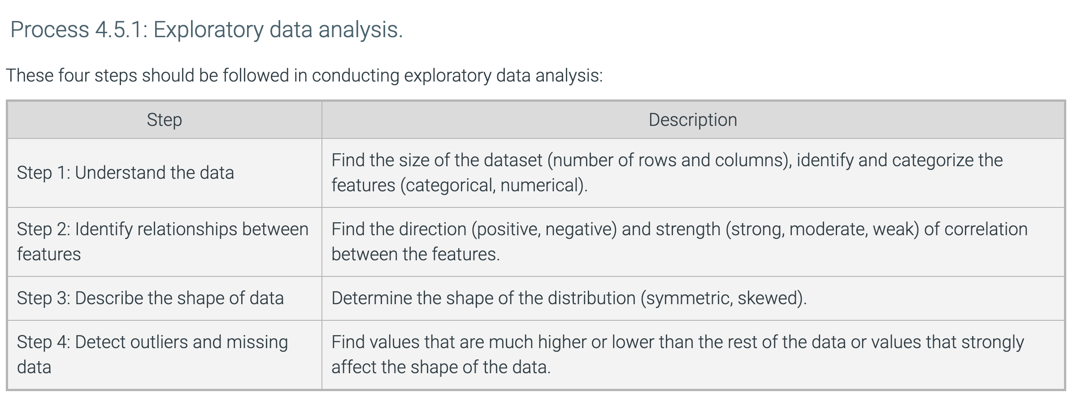
THE Data Prep / EDA Workflow
Step | Description
Step 1: Understand the data | This is done as part of the ”Profile Data” step before analysis. Objective is to understanding the data types, numbers, ranges, overall cleanliness
Step 2: Detect and address Outliers and missing data | Data Cleaning stage. Data needs to be cleaned before analysis; otherwise, analysis could be skewed by dirty data.
Step 3: Describe the shape of each feature of the data. | Use descriptive univariate statistics and visualization to characterize data distributions for each feature.
Step 4: Identify and address correlations between features | (Bivariate and Multivariate Analysis) Assess whether features with high (+/-) correlations can be dropped.
Step 5: Hypothesize | Formulate questions and potential answers based on observations.
Notes:
What is the problem with this sequence? Where should/could we make changes?
In the book, they wait until step 4 to detect and address outliers and missing data. This should be done early on as part of the data cleaning process. You may elect to keep the outliers and missing data until further information is gathered. But it should be identified and addressed as soon as possible. Otherwise, other analyses could be tainted.

Slide 9
Summary: Data Acquisition→ preparation→ Exploration
Data Analysis Processes | Tools
Acquire Data | pd.read_csv(), pd.read_excel(), df.to_csv(index = False), df.to_excel(index = False),
Profile Data | df.head(), df.tail(), df.info(), df.describe(include=‘all’), df.dtypes, df.shape
Manipulate Data | df.groupby(), df.pivot_table(), df.insert()
Clean Data Missing Data Imputing Data Duplicates Outliers Data Types | df.isnull().sum(), df.isna(), df.fillna(value=), df.drop(), df.drop_duplicates(), df.dropna(), df.replace(), df.astype(),
Exploratory Data Analysis Univariate Multivariate Visualization | df.plot(), plt.show(), df.plot.scatter(), df.plot.box(), plt.hist() plt.subplots(figsize=), sns.histplot(), sns.kdeplot(), sns.boxplot(), sns.violinplot() df.mean(), sns.scatterplot(), sns.swarmplot(), sns.stripplot(), plotly.express
Transform Data | preprocessing.scale(), preprocessing.MinMaxScaler().fit_transform() [Part of Modeling because we need to wait until after train/validation/test split before transforming data]
Notes:
It’s best practice to split into train/test sets before scaling. Here’s why:
Data leakage: If you scale before splitting, the scaling parameters (e.g., mean and standard deviation for StandardScaler, min/max for MinMaxScaler) are computed using the entire dataset. That means information from the test set influences the transformation of the training set, which biases evaluation and leads to overly optimistic performance estimates.
Correct workflow:
Split your dataset into train and test sets.
Fit your scaler only on the training set.
Apply the scaler to transform both the training set and the test set (using the same parameters from training).
👉 This way, the test set remains “unseen” and provides a fair estimate of real-world performance.

Slide 10
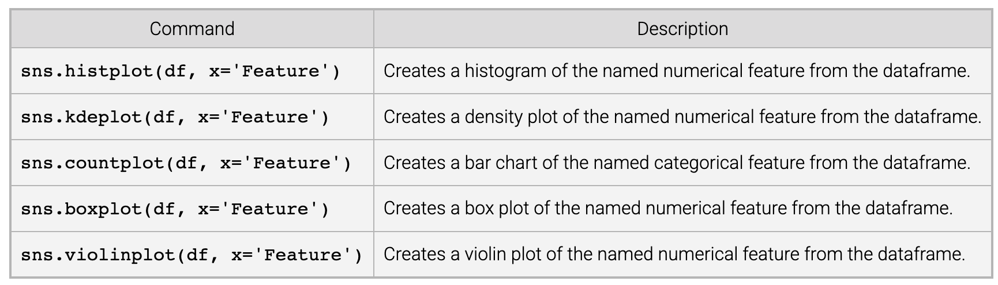
Seaborn Single Feature Plots

Slide 11
Missing Data
“Missing Completely at Random” (MCAR) refers to where the missingness occurs purely by chance and has no relationship with any of the variables in the dataset, either the missing ones or the observed ones.
“Missing at Random” (MAR) refers to where the missingness can be explained by other known (observed) variables in the dataset, but not by the value of the missing variable.
Missing Not at Random” (MNAR) refers to when the missingness is not random and cannot be explained by the observed data. Instead, it is systematically related to the unobserved, missing values.
Imagine a survey where respondents are asked to provide their age and income, and some survey forms are accidentally lost due to a clerical error.
Survey respondents are asked to report their income. Some respondents might not report their income, and the likelihood of not reporting income could depend on their education level (observed) and not on the actual income itself (missing).
In contrast, if higher-income individuals are systematically less likely to report their income regardless of other variables, the data would be “Missing Not at Random” (MNAR).
Notes:
https://en.wikipedia.org/wiki/Survivorship_bias
Types of missing data https://www.ncbi.nlm.nih.gov/books/NBK493614/
Missing at random means that the tendency for a data point to be missing is not related to the missing data itself, but it is related to some of the observed data in the dataset.
The takeaway here for MAR is that the values of the missing data can somehow be predicted from some of the other variables in the dataset.
When data is missing at random, it means that we need to either use an advanced imputation method, such as multiple imputation, or an analysis method specifically designed for missing at random data.
Imagine a survey where respondents are asked to provide their age and income, and some survey forms are accidentally lost due to a clerical error. The missingness of these forms is unrelated to the age, income, or any other variables. The data are missing purely because of the random error, making it an example of “Missing Completely at Random.” In this case, the missingness has no systematic pattern, and all cases have the same likelihood of being missing.
Consider a medical study where patients are asked to report their income. Some patients might not report their income, but the likelihood of not reporting income could depend on their education level (which is observed) and not on the actual income itself (which is missing). In this case, the missingness of income is related to education (an observed variable), so it is considered “Missing at Random.”
In contrast, if higher-income individuals are systematically less likely to report their income regardless of other variables, the data would be “Not Missing at Random” (NMAR).
Key Characteristics of MCAR:
• The likelihood of missing data is the same across all observations.
• The missingness is not systematically related to any other variables, whether observed or unobserved.
Implications: If data are MCAR, the missing data are a random subset of the whole dataset, and analyses on the complete data should not introduce bias, though it may reduce statistical power due to the smaller sample size.

Slide 12
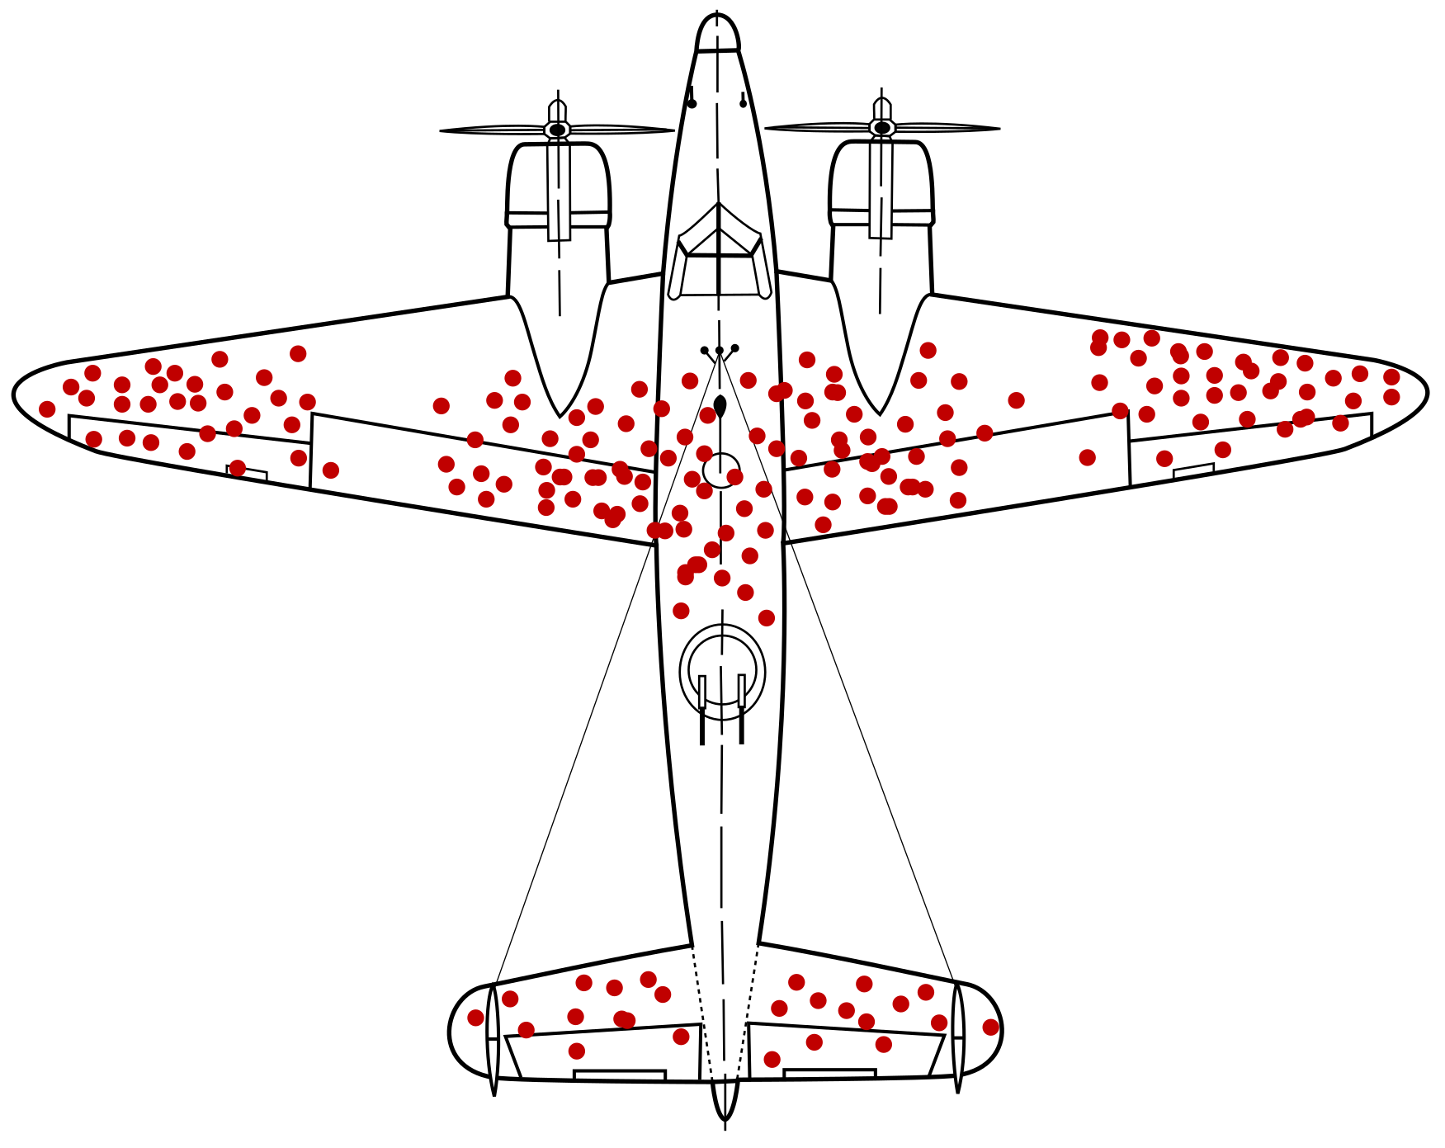
Missing Data More Examples
“Missing Completely at Random” (MCAR) refers to where the missingness occurs purely by chance and has no relationship with any of the variables in the dataset, either the missing ones or the observed ones.
“Missing at Random” (MAR) refers to where the missingness can be explained by other known (observed) variables in the dataset, but not by the value of the missing variable.
Missing Not at Random” (MNAR) refers to when the missingness is not random and cannot be explained by the observed data. Instead, it is systematically related to the unobserved, missing values.
A lab instrument randomly fails to record cholesterol values, regardless of patient age, weight, or true cholesterol.
Younger patients (<35 years) are less likely to get cholesterol measured, but given their age, missingness is unrelated to the actual cholesterol value.
Patients with very high cholesterol hide their results, so missingness is directly tied to high cholesterol levels.
Notes:
In the WWII RAF airplane bullet holes example, the missingness was Missing Not at Random (MNAR).
Here’s why:
Analysts saw bullet holes concentrated in certain parts of planes returning from missions.
But the data was missing information about planes that did not return (i.e., those that were shot down).
The absence of bullet holes in certain areas (like the engines) was not random—it was directly tied to whether the plane survived.
👉 This is MNAR, because the missing data mechanism depends on the unobserved outcome itself (planes destroyed in combat).

Slide 13
Missing Data--What you Do Depends on the Type of Missing
MCAR → scattered randomly. Safe to drop missing rows (unbiased).
MAR → missingness related to observed variable (e.g., Age). Use imputation or models that adjust for related variables.
MNAR → missingness related to the unobserved (missing) variable itself (e.g., high cholesterol). Requires explicit modeling of the missingness mechanism.
[This is straightforward with the WWII airplane example, but can be very complex otherwise.]
Notes:
🔎 Why MAR is easier than MNAR
In MAR (e.g., younger patients less likely to get cholesterol tests), the missingness depends on observed variables (Age). You can use those variables in your model or imputation and recover unbiased estimates.
In MNAR (e.g., patients with high cholesterol are more likely to hide results), the missingness depends on the unobserved value itself. You can’t just “control” for another variable—you’re missing the very thing you need.
🛠️ How to handle MNAR
There’s no single fix, but here are standard approaches:
1.
Selection Models (Heckman Correction)
Common in economics.
Idea: jointly model the outcome (e.g., cholesterol) and the selection process (probability of reporting).
Example: In wages studies, low-income individuals may not report earnings. Heckman’s two-step model estimates the wage equation and the reporting probability equation simultaneously to correct the bias.
2.
Pattern-Mixture Models
Model the data distribution separately for different missingness patterns.
Example: Split patients into “reported cholesterol” vs. “did not report.” You then assume or estimate how the unreported group differs (e.g., on average +30 mg/dL higher).
3.
Sensitivity Analysis
Often, you can’t know the true missingness mechanism. Instead, you run models under different assumptions.
Example: Assume unreported cholesterol is 10, 20, or 30 mg/dL higher than observed cases, and check how results change.
4.
Collect Auxiliary Data
Sometimes the best solution is to design data collection to reduce MNAR.
Example: Instead of relying on self-reported cholesterol, require lab measurements (so patients can’t selectively hide values).
✅ Example Walkthrough
Imagine a study of patient income:
Missingness: people with very low incomes are less likely to disclose.
If you compute mean income only on the disclosed group → biased upward.
Fix with Heckman model:
Step 1: Estimate probability of reporting income (selection equation) using variables like education, age, employment status.
Step 2: Correct the income regression with an adjustment term (“inverse Mills ratio”) from step 1.
The final adjusted mean income accounts for the fact that low-income people systematically drop out.
⚠️ Key takeaway: With MNAR, you must explicitly model why data is missing or make plausible assumptions about the missing values. Otherwise, the bias remains hidden.
M

Slide 14
Missing Data Quiz 1
1. Which of the following best defines “Missing Completely at Random” (MCAR)?
a) The missingness is related to both observed and missing data.
b) The missingness is related to observed data but not missing data.
c) The missingness is unrelated to both observed and missing data.
d) The missingness is related to the missing data only.
2. In which of the following scenarios is data considered “Missing Not at Random” (MNAR)?
a) Data is missing due to a random system failure.
b) Patients with higher incomes are less likely to report their income.
c) Missingness is related to other observed variables, like age or gender.
d) Missing data occurs randomly across the dataset.
3. Which type of missing data is easiest to handle without introducing bias in analyses?
a) Missing Not at Random (MNAR)
b) Missing Completely at Random (MCAR)
c) Missing at Random (MAR)
d) None of the above
4. Which of the following is true about “Missing at Random” (MAR)?
a) Missingness is explained by variables that are not observed.
b) Missingness is random and unrelated to any variables in the dataset.
c) Missingness is related to observed variables but not the missing data itself.
d) Missingness is dependent on the value of the missing data.

Slide 15
Missing Data Quiz 2
5. Which of the following techniques can help handle data that is “Missing at Random” (MAR)?
a) Removing all missing data rows.
b) Imputing missing values based on observed variables.
c) Ignoring the missing data and proceeding with the analysis.
d) Using the mean of the missing variable to fill in the gaps.
6. If data is Missing Completely at Random (MCAR), removing missing data points will not introduce bias.
(True / False)
7. Data that is Missing Not at Random (MNAR) can be safely ignored without any effect on the analysis.
(True / False)
8. Missing at Random (MAR) means the missingness is related to the unobserved, missing data itself.
(True / False)
Notes:
1. Which of the following best defines “Missing Completely at Random” (MCAR)?
Answer: c) The missingness is unrelated to both observed and missing data.
2. In which of the following scenarios is data considered “Missing Not at Random” (MNAR)?
Answer: b) Patients with higher incomes are less likely to report their income.
3. Which type of missing data is easiest to handle without introducing bias in analyses?
Answer: b) Missing Completely at Random (MCAR)
4. Which of the following is true about “Missing at Random” (MAR)?
Answer: c) Missingness is related to observed variables but not the missing data itself.
5. Which of the following techniques can help handle data that is “Missing at Random” (MAR)?
Answer: b) Imputing missing values based on observed variables.
True/False Questions:
6. If data is Missing Completely at Random (MCAR), removing missing data points will not introduce bias.
Answer: True
7. Data that is Missing Not at Random (MNAR) can be safely ignored without any effect on the analysis.
Answer: False
8. Missing at Random (MAR) means the missingness is related to the unobserved, missing data itself.
Answer: False

Slide 16
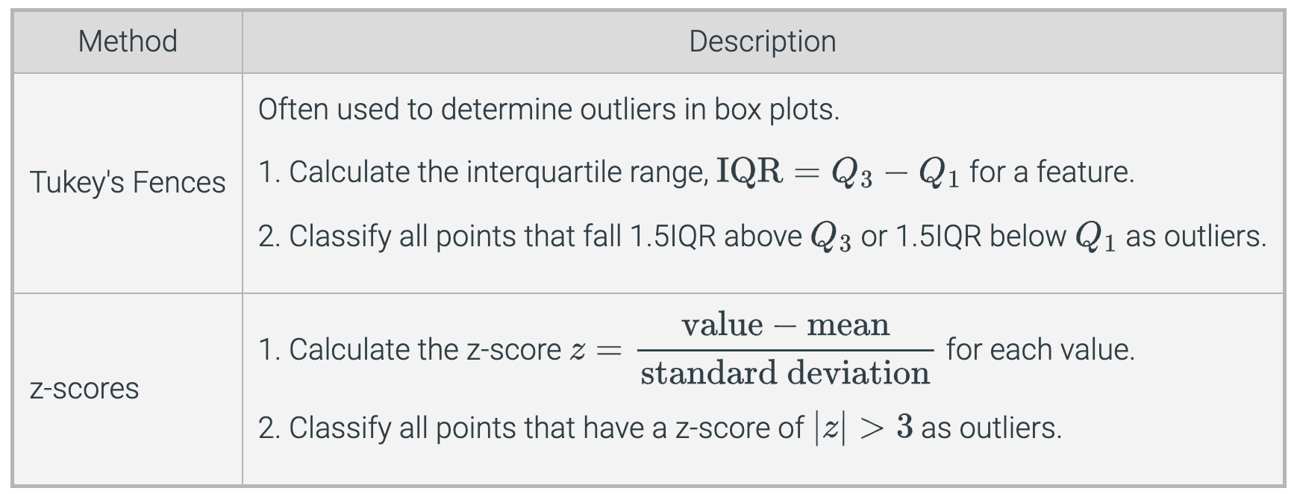
Outlier Detection

Slide 17
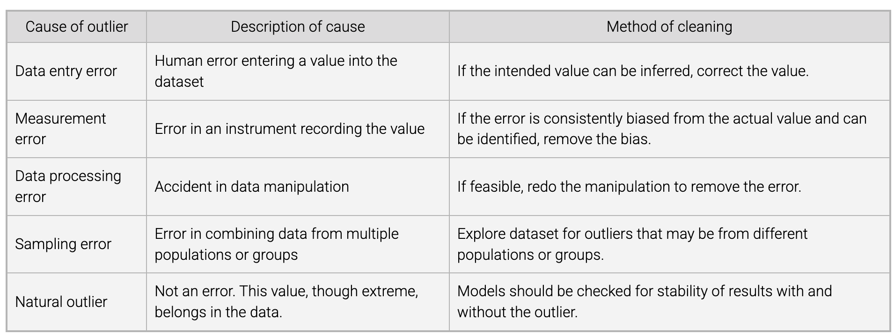
Dealing with Outliers

Slide 18
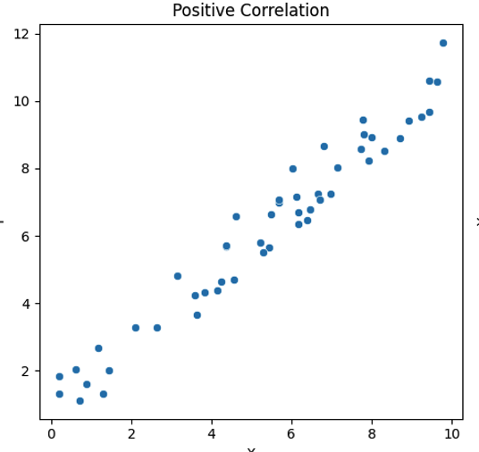
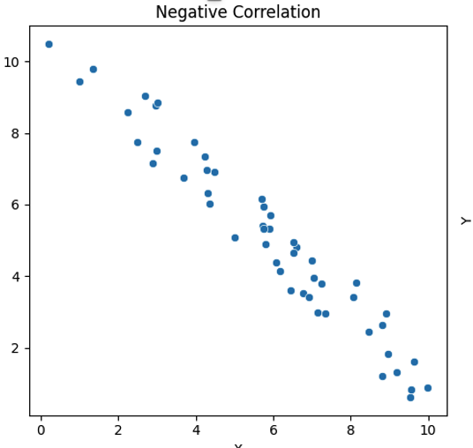
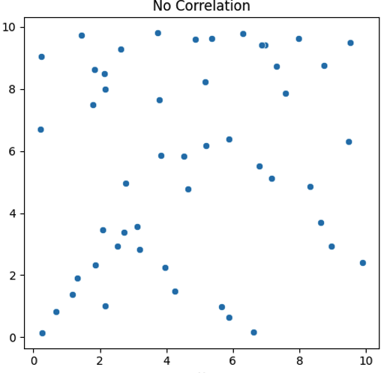
Correlation
Correlation is a statistical measure that describes the degree to which two variables move in relation to each other.
If one variable increases while the other tends to increase, they are positively correlated.
If one increases while the other decreases, they are negatively correlated.
The correlation is close to zero if they don’t move together systematically.
Random

Slide 19
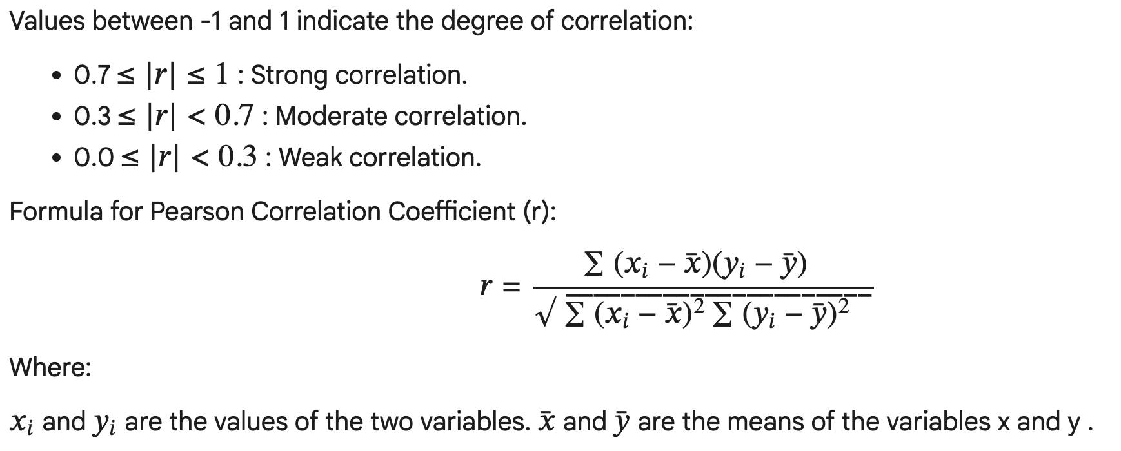
Pearson Correlation
The most common type of correlation measure is the Pearson correlation coefficient (r), which ranges from -1 to +1.
Interpretation of Pearson Correlation Coefficient (r):
• r = 1 : Perfect positive linear relationship. As one variable increases, the other variable increases proportionally. • r = -1 : Perfect negative linear relationship. As one variable increases, the other decreases proportionally. • r = 0 : No linear relationship between the variables.

Slide 20
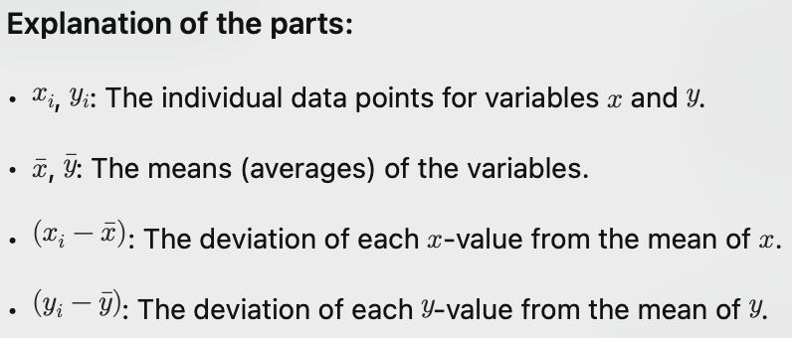
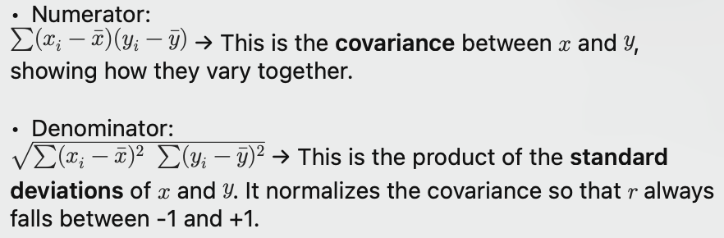
Pearson Correlation interpretation

Slide 21
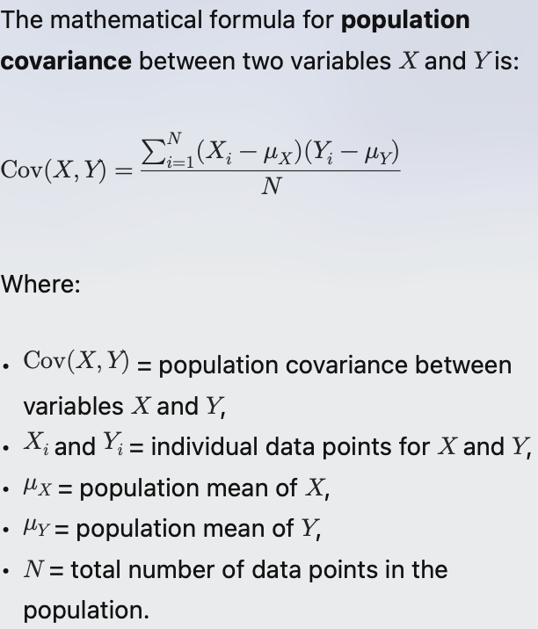
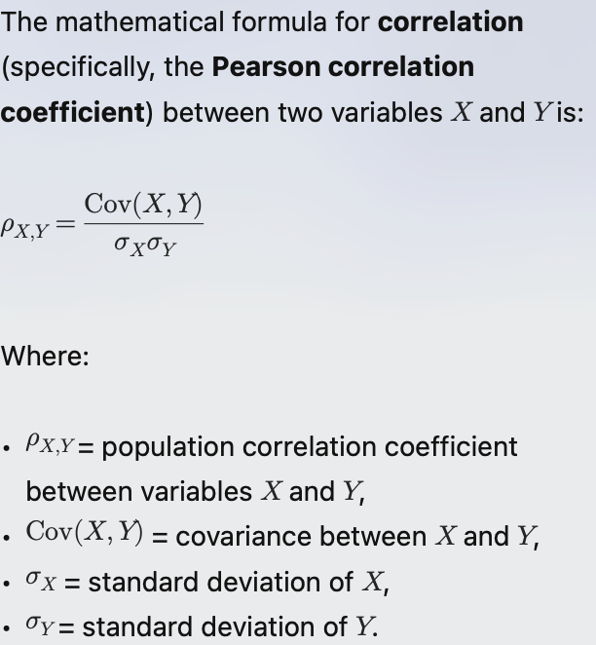
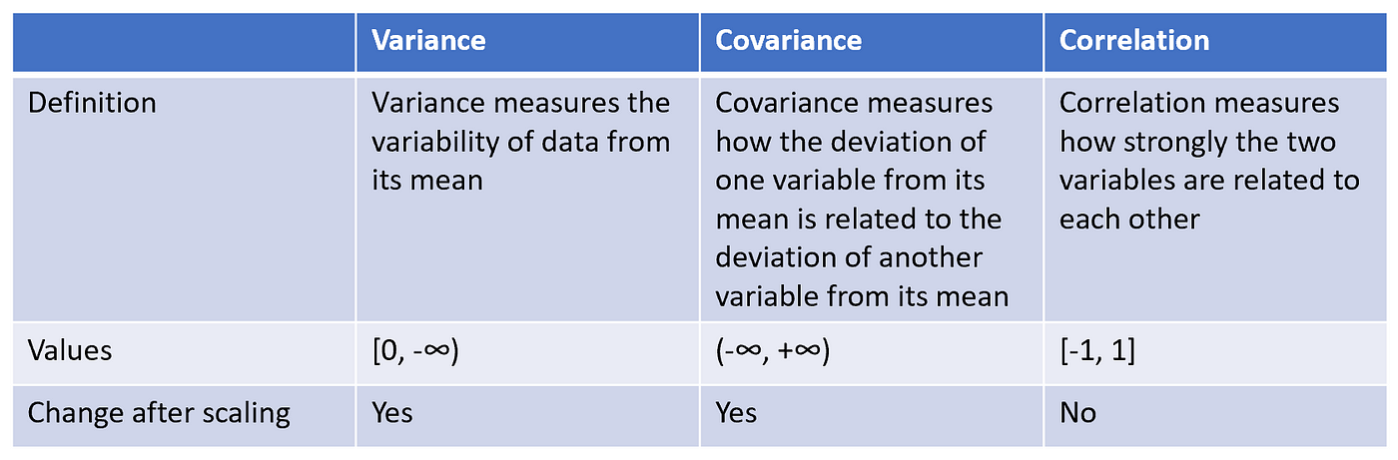
Covariance vs Correlation

Slide 22
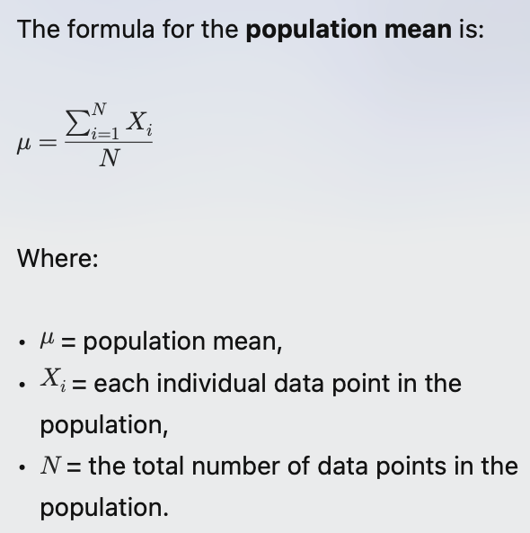
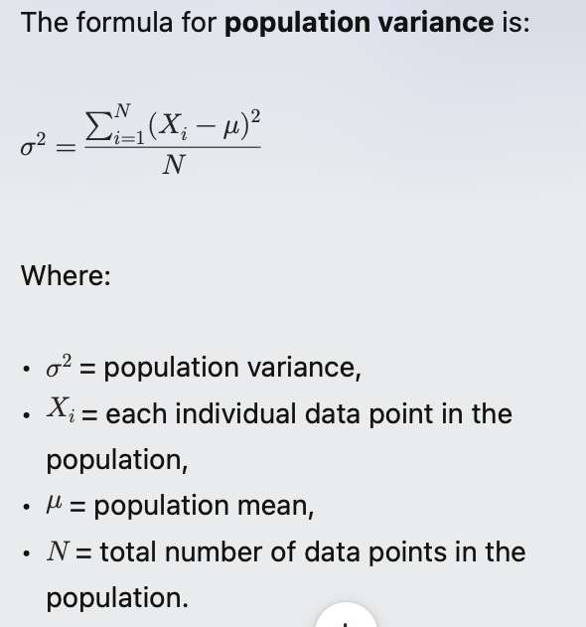
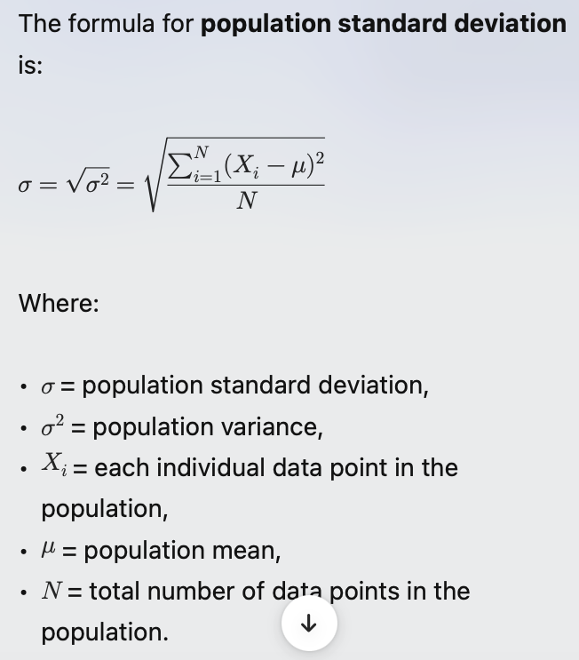
Mean, Variance, Standard Deviation
Notes:
The intuitive difference between variance and standard deviation lies in how they represent the spread or dispersion of a set of data points:
1. Variance:
• Definition: Variance measures the average of the squared differences from the mean. It gives a sense of how much the data points deviate from the mean.
• Interpretation: Since variance is in squared units (e.g., if your data is in meters, variance is in square meters), it can be less intuitive for practical interpretation. A higher variance indicates that data points are spread out over a wider range.
2. Standard Deviation:
• Definition: Standard deviation is the square root of the variance. It provides a measure of spread in the same units as the original data.
• Interpretation: Because standard deviation is in the same units as the data, it is generally more intuitive. A smaller standard deviation indicates that the data points tend to be closer to the mean, while a larger standard deviation indicates more spread.
Example:
• Consider a set of test scores: 70, 75, 80, 85, 90.
• Variance gives you an idea of how much the scores vary, but it’s in squared score units.
• Standard Deviation tells you, in actual score units, how much the scores typically differ from the average score (which would be around 80 in this case).
In summary, variance provides a mathematical measure of spread, while standard deviation translates that measure back into the original unit, making it more relatable and easier to understand.

Slide 23
Why is Correlation Important in EDA?
During EDA, correlation helps you understand relationships between variables, which is crucial for:
Feature Selection
Strongly correlated features may provide redundant information.
Detecting this helps avoid multicollinearity (important in regression models).
Understanding Patterns
Correlations reveal how variables interact.
For example, in sales data, advertising spend may strongly correlate with revenue.
Detecting Potential Causation Candidates
Correlation doesn’t prove causation, but it highlights variables worth deeper investigation.
Dimensionality Reduction
Highly correlated variables can sometimes be combined or reduced with techniques like PCA (Principal Component Analysis).
Identifying Data Issues
Unexpected correlations (or lack of correlation) may point to data errors, outliers, or biases.

Slide 24
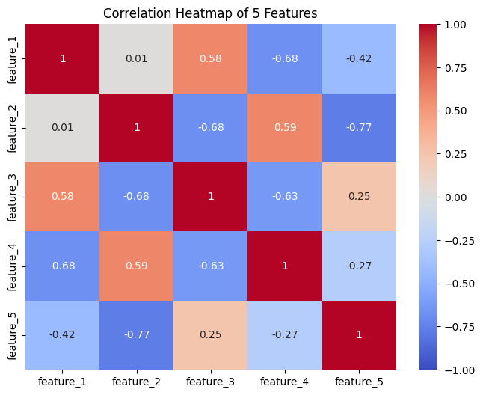
Heatmap of Data Correlations
A heatmap is an excellent way to visualize the correlation between multiple features.
Using Seaborn, a Python visualization library built on top of Matplotlib, you can create a heatmap to display the correlation matrix between many features.
Steps:
1. Compute the correlation matrix between the features using pandas.
2. Plot the heatmap using Seaborn's heatmap() function()
3. Colors indicate relative correlation

Slide 25
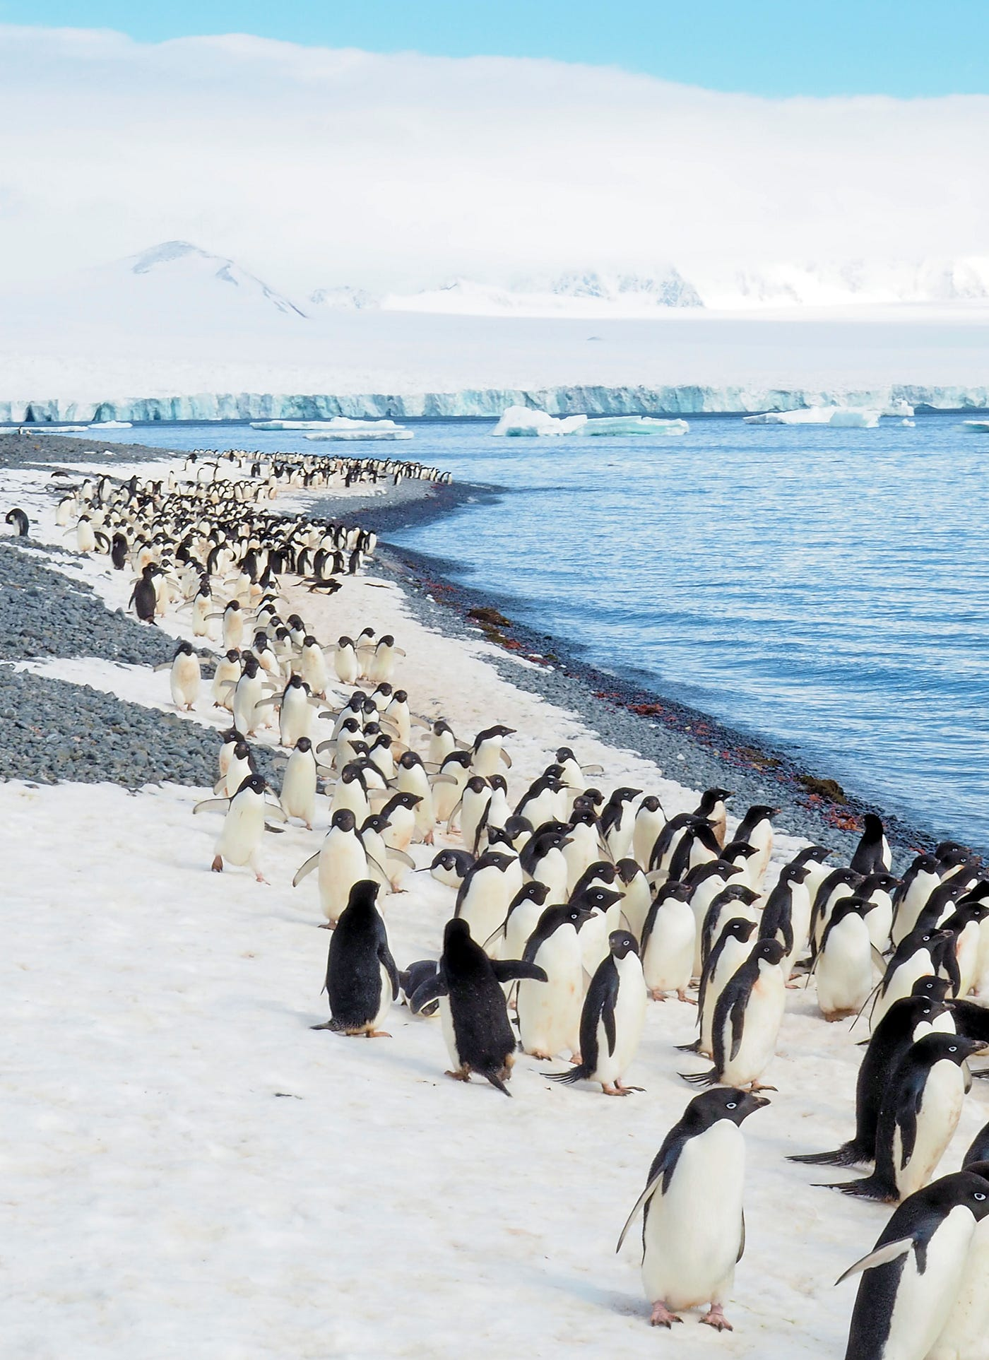
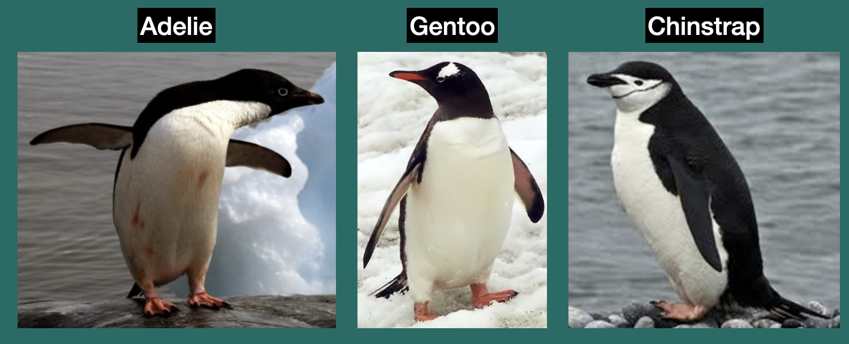
EDA Case Study: Palmer Penguins
Scenario: Imagine we are data scientists studying penguin populations. We have a dataset containing various measurements.
Goal of EDA: To understand the characteristics of different penguin species, how they vary across islands, and potential factors influencing their size and dimensions.
This understanding will inform ecological studies, conservation efforts, or even predictive models for species identification.
Data collectors: Dr. Kristen Gorman and the Palmer Station Long Term Ecological Research (LTER) Program.
Time frame: Measurements were taken from 2007–2009.
Location: Palmer Archipelago, Antarctica.
Notes:
Data Citation: Gorman, K. B., Williams, T. D., & Fraser, W. R. (2014) Ecological Sexual Dimorphism and Environmental Variability within a Community of Antarctic Penguins (Genus Pygoscelis). PLoS ONE 9(3): e90081. doi:10.1371/journal.pone.0090081.
Package Citation: Horst, A. M., Hill, A. P., & Gorman, K. B. (2020). palmerpenguins: Palmer Archipelago (Antarctica) penguin data. R package version 0.1.0. https://allisonhorst.github.io/palmerpenguins/.

Slide 26
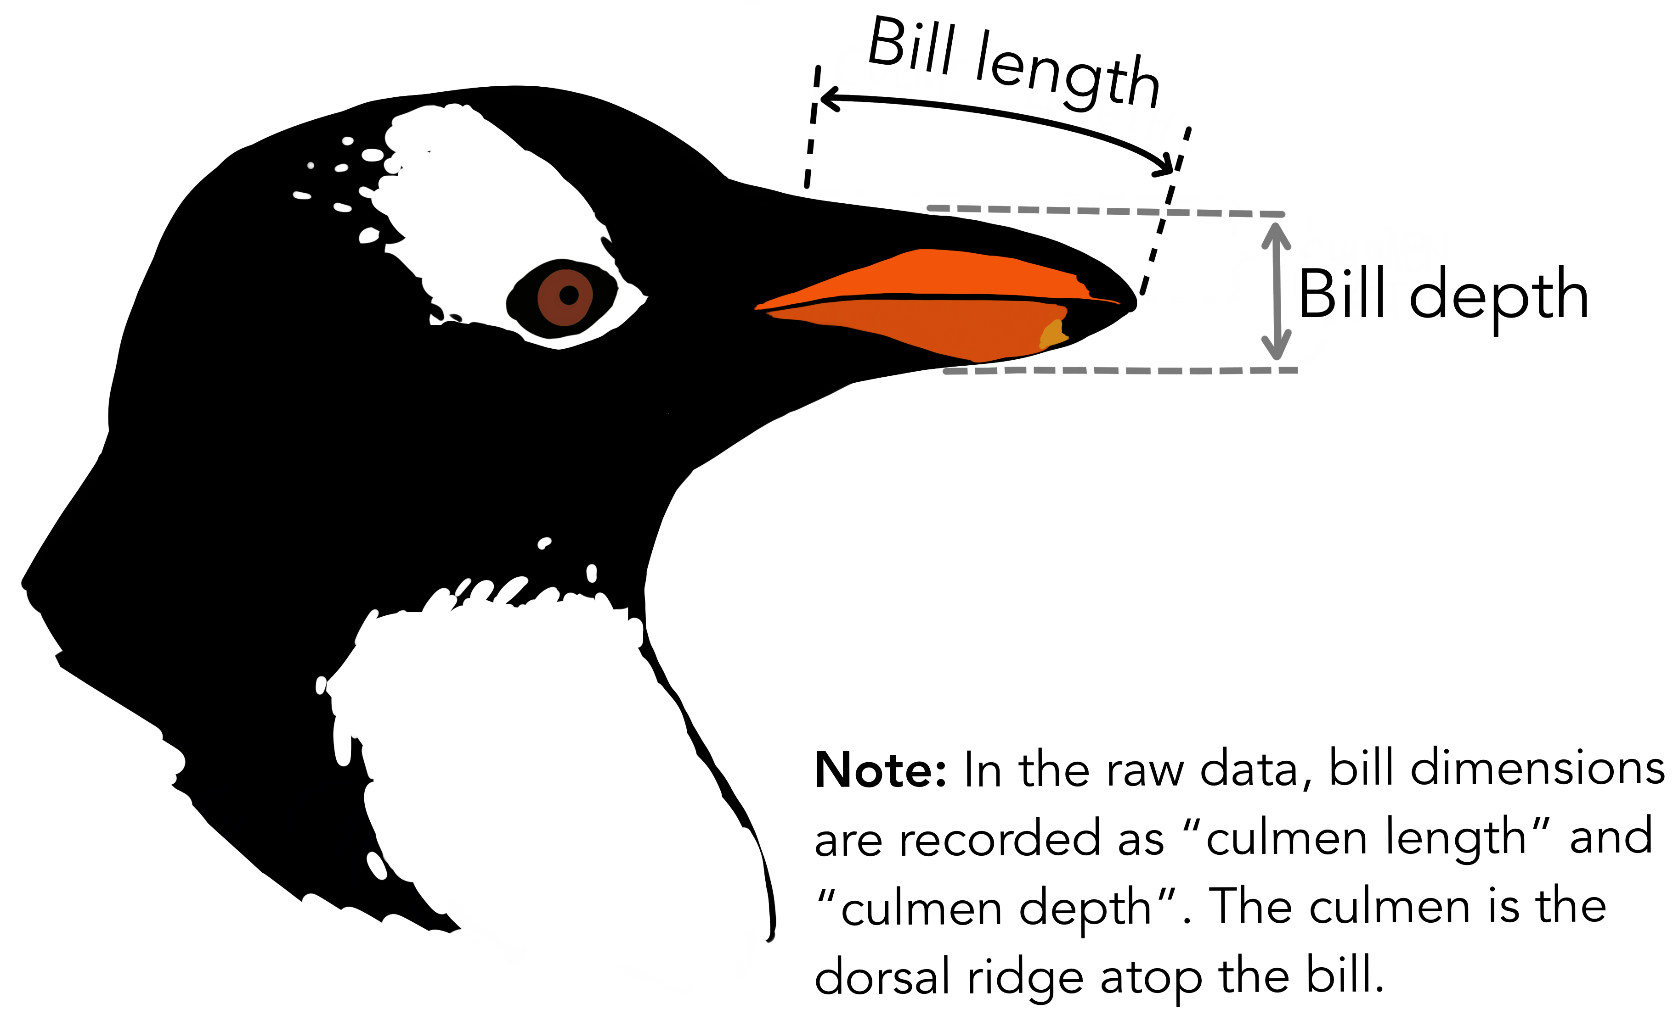
Palmer Penguins Dataset Variables
species: Adélie, Chinstrap, and Gentoo.
island: Biscoe, Dream, and Torgersen.
bill_length_mm: Length of the penguin's culmen (bill).
bill_depth_mm: Depth of the penguin's culmen.
flipper_length_mm: Length of the penguin's flipper.
body_mass_g: The penguin's body mass.
sex: Male or female.
Notes:
“Adélie” (as in the Adélie penguin) is pronounced “ah-DEL-ee”.

Slide 27
Hands-on Activity: Explore your Penguins!
Instructions:
Load the data: Ensure you have the penguins_cleaned DataFrame from our earlier steps.
Task 1: Summarize 'island'
Calculate the frequency of penguins on each island.
Create a bar plot of island counts.
Task 2: Visualize 'flipper_length_mm' vs. 'body_mass_g'
Create a scatter plot of flipper_length_mm vs. body_mass_g.
Color the points by sex.
Task 3: Formulate a Hypothesis
Based on your plots from Task 1 and 2, write down one observation or a simple hypothesis (e.g., "Penguins on Island X tend to be larger").

Slide 28
What we Can Learn
Key takeaways from the dataset
Summary:
The three penguin species in the study show distinct patterns in their physical characteristics (size and bill shape).
The data can be effectively used for exploratory analysis, visualization, and training simple machine learning models.
The project highlights the value of accessible and approachable datasets for educational purposes.

Slide 29
Multiple Choice: Which of these Pandas functions is best for getting a quick summary of descriptive statistics (mean, std, min, max) for numerical columns?
a) df.info()
b) df.describe()
c) df.head()
d) df.isnull().sum()
True/False: A high correlation coefficient (e.g., 0.9) between two variables always implies that one causes the other.
Short Answer: Why might you choose to use df.fillna(df['column'].median()) instead of df.fillna(df['column'].mean()) for missing numerical data?
Multiple Choice: If you want to visualize the distribution of a single continuous numerical variable, which plot is most appropriate?
a) Scatter Plot
b) Bar Chart
c) Histogram
d) Heatmap

